Slide 1
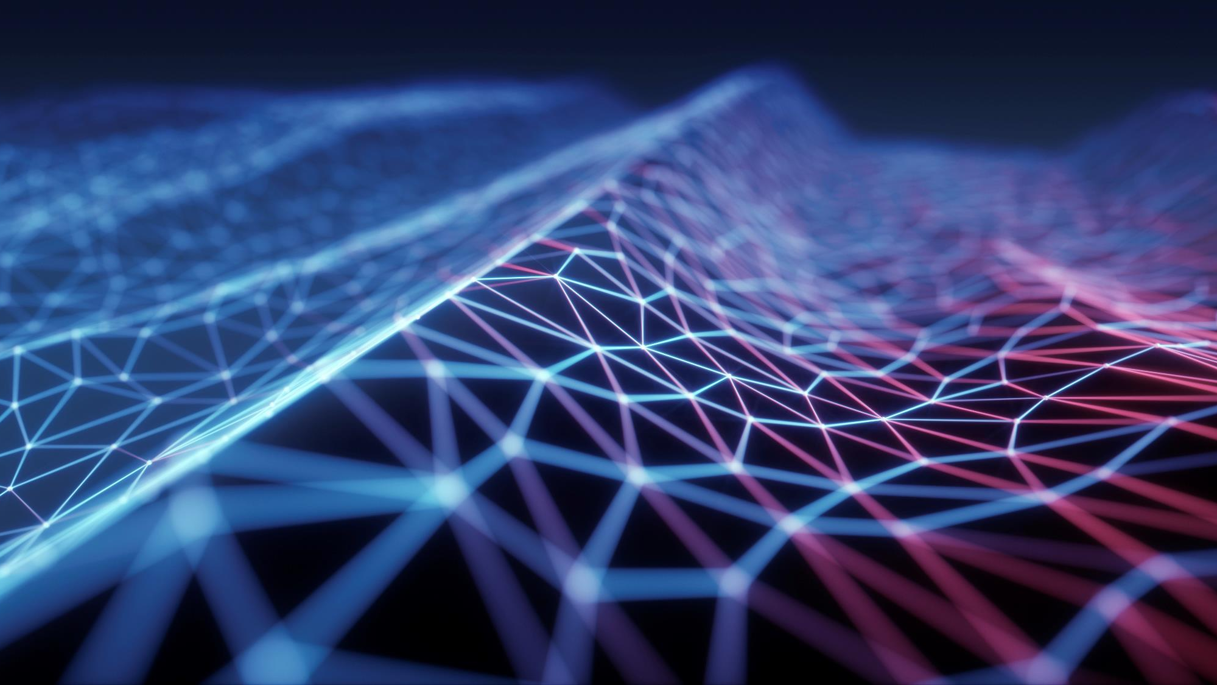
Image recognitions
Image recognition, also known as computer vision, is a challenging and exciting field in AI and machine learning. If you're working on a problem related to image recognition, here's a general outline of how to approach it:

Slide 2
Problem Definition Define the specific image recognition problem you're addressing. Is it object detection, facial recognition, or something else?

Slide 3
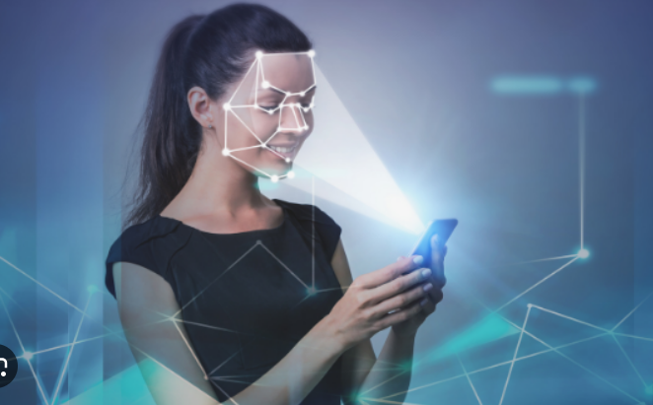
solution
Deep learning techniques, particularly Convolutional Neural Networks (CNNs), have revolutionized facial recognition.
Techniques like data augmentation are used to create variations of the training data by applying transformations.
Face alignment methods are used to preprocess images by locating facial landmarks (e.g., eyes, nose, mouth) and aligning faces in a standardized way.

Slide 4

Tech Stack
Image Acquisition
Feature Extraction
Data Preprocessing

Slide 5
How our Idea is Unique
Through this We can easily recognized those person who are present in
our database.
In this project we get more information about that person like (Name, Address, Profession , DOB , Qualification, etc).
We have develop this for two purpose
i) Get Information about Person.
ii) If data is not present in database then it insert the data of that person.

Slide 6

:Architecture of Idea
Face Identity
Varification
Comparision and Identification
Feature Extraction
Feature Extraction
Face detection and cropping
Face detection and cropping
Test Image or Input Query

Slide 7

Thank You
Team phoenix

